Slide 1

Algebra 1
Unit 5, Lesson 2 Solving Equations and Rearranging Formulas Volume 1, pg. 235

Slide 2


Benchmarks
MA.912.AR.2.1
Given a real-world context, write and solve one-variable multi-step linear equations.
MA.912.AR.1.2
Rearrange equations or formulas to isolate a quantity of interest.
volume 1, pg. 235

Slide 3
Integrated Mathematical Thinking and Reasoning Standards
MA.K12.MTR.2.1 Demonstrate understanding by representing problems in multiple ways.
MA.K12.MTR.4.1 Engage in discussions that reflect on the mathematical thinking of self and others.
MA.K12.MTR.5.1 Use patterns and structure to help understand and connect mathematical concepts.
volume 1, pg. 235

Slide 4

Learning Targets
I can solve multi-step linear equations.
I can isolate a quantity of interest in a formula by rearranging a formula.
volume 1, pg. 235

Slide 5

Warm-Up
volume 1, pg. 236

Slide 6
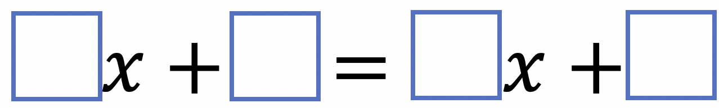
5.2.1 Warm-Up: Closest to Zero
Place a digit in each blue box to make the equation true for only one value of $x$. Use only the digits $1$ to $9$, but digits can be used more than once.
volume 1, pg. 236

Slide 7

Collaboration
volume 1, pg. 236

Slide 8

5.2.2 Collaboration: Find the Error
Sandra, Jerry, Marly, and Xavier solved the same equation and each found different solutions. Each student’s work and solution are shown in the table.
Work with your partner to examine the work shown and determine who solved the equation correctly. Then, for the students who made errors, circle the step where the error was made and explain the error.
volume 1, pg. 236

Slide 9
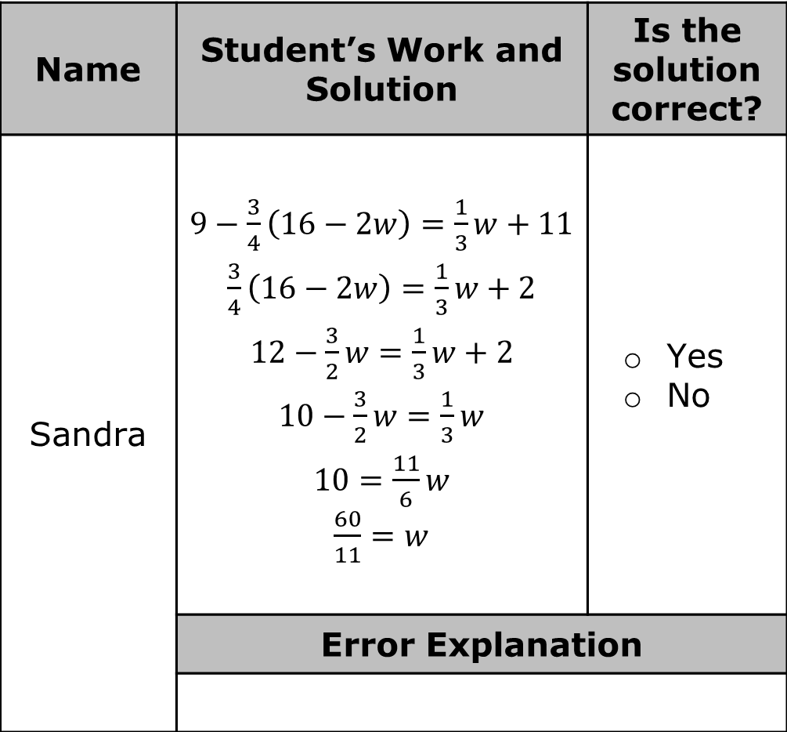
Name | Student’s Work and Solution | Is the solution correct?
Sandra | $9−\frac{3}{4}\left(16−2w\right)=\frac{1}{3}w+11$ $\frac{3}{4}\left(16−2w\right)=\frac{1}{3}w+2$ $12−\frac{3}{2}w=\frac{1}{3}w+2$ $10−\frac{3}{2}w=\frac{1}{3}w$ $10=\frac{11}{6}w$ $\frac{60}{11}=w$ | Yes No
 | Error Explanation
volume 1, pg. 236

Slide 10

Name | Student’s Work and Solution | Is the solution correct?
Jerry | $9−\frac{3}{4}\left(16−2w\right)=\frac{1}{3}w+11$ $9−12+\frac{3}{2}w=\frac{1}{3}w+11$ $−3+\frac{3}{2}w=\frac{1}{3}w+11$ $−3=\frac{7}{6}w+11$ $−14=\frac{7}{6}w$ $$−12=w$$ | Yes No
 | Error Explanation
volume 1, pg. 236

Slide 11

Name | Student’s Work and Solution | Is the solution correct?
Marly | $9−\frac{3}{4}\left(16−2w\right)=\frac{1}{3}w+11$ $9−12+\frac{3}{2}w=\frac{1}{3}w+11$ $−3+\frac{3}{2}w=\frac{1}{3}w+11$ $\frac{3}{2}w=\frac{1}{3}w+14$ $\frac{7}{6}w=14$ $$w=12$$ | Yes No
 | Error Explanation
volume 1, pg. 237

Slide 12

Name | Student’s Work and Solution | Is the solution correct?
Xavier | $9−\frac{3}{4}\left(16−2w\right)=\frac{1}{3}w+11$ $9−12−\frac{3}{2}w=\frac{1}{3}w+11$ $−3−\frac{3}{2}w=\frac{1}{3}w+11$ $−\frac{3}{2}w=\frac{1}{3}w+14$ $−\frac{5}{6}w=14$ $$w=−16.8$$ | Yes No
 | Error Explanation
volume 1, pg. 237

Slide 13

Guided Instruction
volume 1, pg. 237

Slide 14

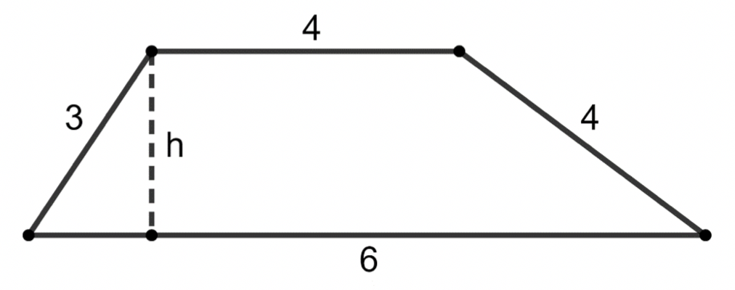
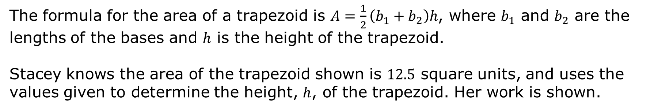
5.2.3 Guided Instruction: Rearranging Formulas
The formula for the area of a trapezoid is $A=\frac{1}{2}\left(b_{1}+b_{2}\right)h$, where $b_{1}$ and $b_{2}$ are the lengths of the bases and $h$ is the height of the trapezoid.
Stacey knows the area of the trapezoid shown is $12.5$ square units, and uses the values given to determine the height, $h$, of the trapezoid. Her work is shown.
volume 1, pg. 237

Slide 15
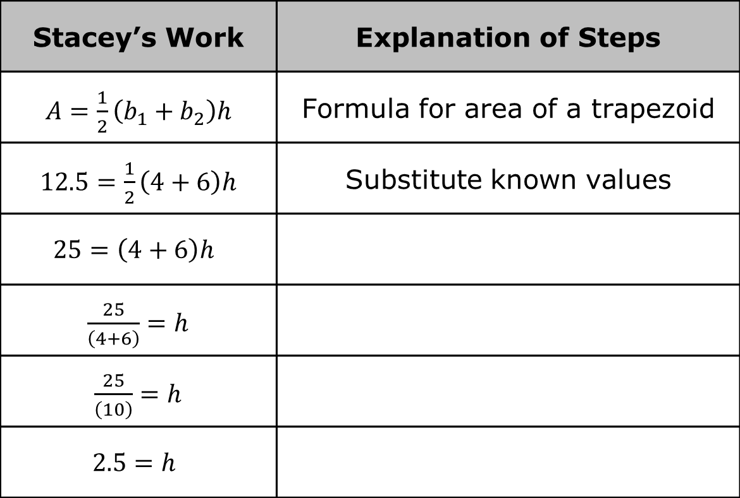
Complete the table to explain each step of Stacey’s work.
Stacey’s Work | Explanation of Steps
$A=\frac{1}{2}\left(b_{1}+b_{2}\right)h$ | Formula for area of a trapezoid
$12.5=\frac{1}{2}\left(4+6\right)h$ | Substitute known values
$$25=\left(4+6\right)h$$
$\frac{25}{\left(4+6\right)}=h$
$\frac{25}{\left(10\right)}=h$
$$2.5=h$$
volume 1, pg. 237

Slide 16
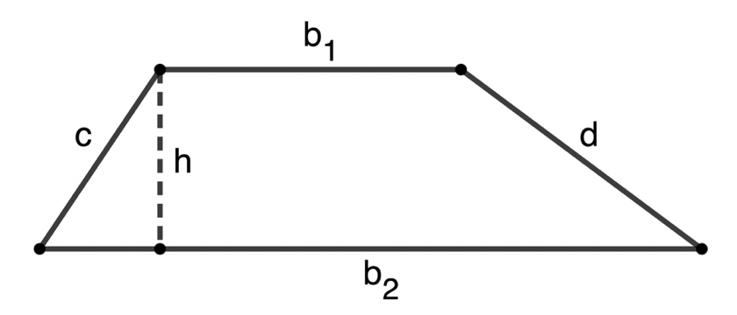
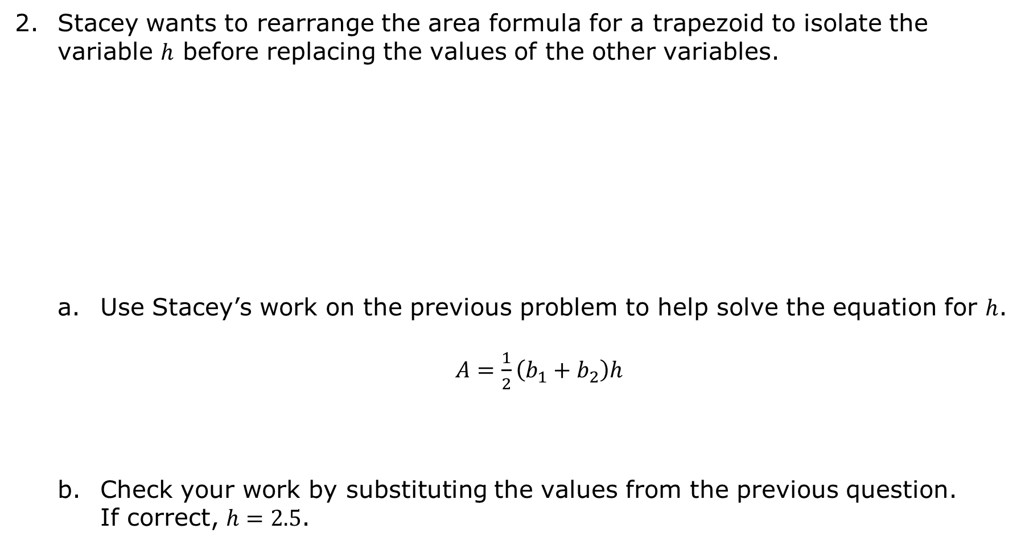
Stacey wants to rearrange the area formula for a trapezoid to isolate the variable $h$ before replacing the values of the other variables.
Use Stacey’s work on the previous problem to help solve the equation for $h$.
$A=\frac{1}{2}\left(b_{1}+b_{2}\right)h$
Check your work by substituting the values from the previous question. If correct, $h=2.5$.
volume 1, pg. 238

Slide 17
Explain the similarities and differences between rearranging the formula to isolate $h$ and Stacey’s work to find the value of $h$.
Similarities | Differences
volume 1, pg. 238

Slide 18
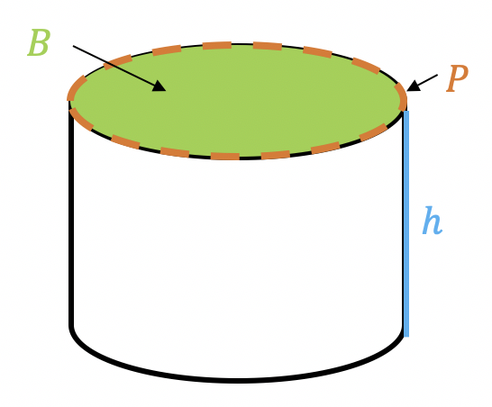

The formula for the total surface area of a cylinder, $S$, is $S=2B+Ph$, where $B$ is the area of the base, $P$ is the perimeter of the base, and $h$ is the height of the cylinder.
Rearrange the formula for the surface area of a cylinder to isolate the variable $h$.
$$S=2B+Ph$$
volume 1, pg. 238

Slide 19

Your Turn
volume 1, pg. 239

Slide 20
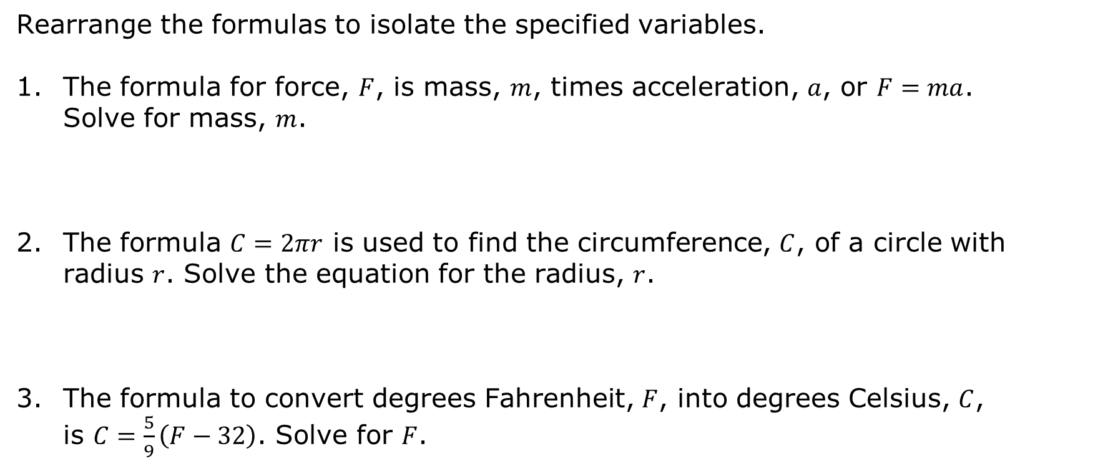
5.2.4 Your Turn!
Rearrange the formulas to isolate the specified variables.
The formula for force, $F$, is mass, $m$, times acceleration, $a$, or $F=ma$. Solve for mass, $m$.
The formula $C=2πr$ is used to find the circumference, $C$, of a circle with radius $r$. Solve the equation for the radius, $r$.
The formula to convert degrees Fahrenheit, $F$, into degrees Celsius, $C$, is $C=\frac{5}{9}\left(F−32\right)$. Solve for $F$.
volume 1, pg. 239

Slide 21

Wrap-Up
volume 1, pg. 239

Slide 22
5.2.5 Wrap-Up: Growth Mindset
Choose two of the following prompts to complete.
Describe a new strategy you learned today.
Describe a mistake you made and what you learned from it.
Explain one way you challenged yourself today.
volume 1, pg. 239

